Slide 1
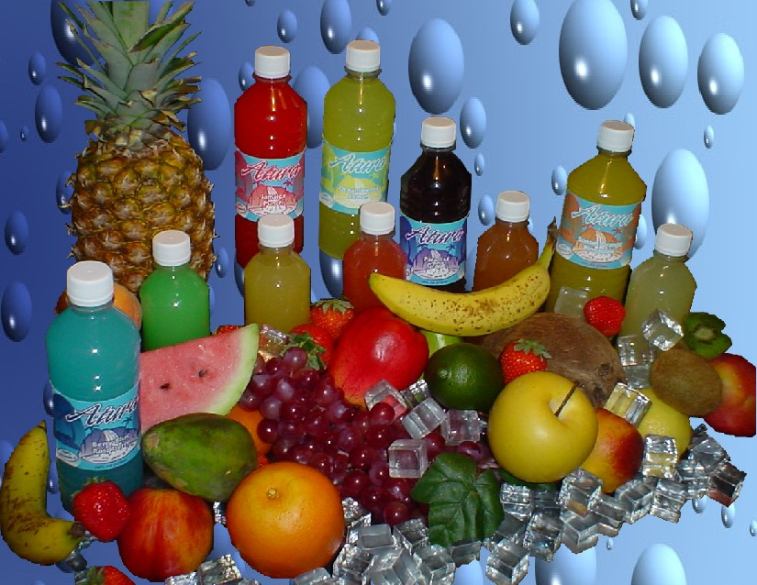
NUTRITION IN SPORTS FOOD
Submitted by:
Prixit Guleria
Deptt. OF SNPT
Kanya Mahavidalaya Kharkhoda

Slide 2
INTRODUCTION
Taking in to the consideration the fact that sports person need more energy to carry out their sporting activity effectively than a normal person.
At the game day most of their body’s energy come from the foods you have eaten over the past several days. So they have need careful planning & implementation.
There are lot of things that deserve proper attention. Like

Slide 3
Selection of food.
Timing of food intake.
Selection of nutrition supplement.
All these depand on the
Sports person’s energy need.
Body composition, sex, nutritional need.

Slide 4
SOME NUTRITION DIET TIPS
There is need to eat food before, during & after your exercise as help to control the blood glucose level.
It is advisable for sports person to eat a balance diet consisting of plenty of proteins, vitamins, minerals & optimum carbohydrates food.
Do not change your diet plan before going in your sports competition.
If you feel some kind of an uncomfort or pain in your abdomen or intestine then you must have a high fiber high fat content food in your pre exercise sports meal.

Slide 5
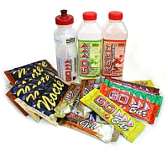
SPORTS FUEL
CARBOHYDRATES
PROTEIN
FAT
WATER

Slide 6
CARBOHYDRATES
Our body absorbed carb. In the form of glucose. When we exercise aerobically our body 1st burns the glucose. So we need more carb.
If a person do not eat more carb. They will tire more quickly. So they need more carb. For increasing the stamina.
Sugary carb. Such as candy bars or sodas are less healthy for sports person bz they do not contain any of the other nutrients you need. They give the quick burst of energy .

Slide 7
REQUIREMENTS- The exact amount of carb. Required depands on an indivisual’s training & personal requirement.
The daily req. can be range from 2.7 to 4.5gm per pound ( 6-10 per kgm of body weight) e.g. an athlete training 2-4 hours daily would need about 360-600 of carb. Per day

Slide 8
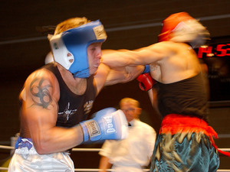
PROTEIN
Protein required in moderate amount. Too much protein can cause harm to the body.
Proteins need mainly for the large strong musscles.
REQUIREMENT- The sports person mainly take more protein in their regular diet, which is harmful. An athlete need 145-154gm of protein per day 9 about 3 small chicken breasts) there is no scientific evidence gm of protein per kg of body weight has any additional benefit in muscle strength or size.

Slide 9
HIGH PROTEIN CAN HURT THE PERFORMANCE IN FOLLOWING WAYS
Decreased endurance
Reduced muscle glycogen stores in the muscle & liver
Decrease max. efforts
Decrease serum glucose level
Increase risk of HYPOGLYCEMIA
Causing dehydration

Slide 10
FAT
Many sports person avoid the fats in their diet bz. Of increasing of weight.
But fat is very important in our nutrition
That because active muscle quickly burn through carbs. And need fats for long lasting energy
Avoid eating if fat before a few hrs. of exercising. Fat is stored when we consume more calories then use .

Slide 11
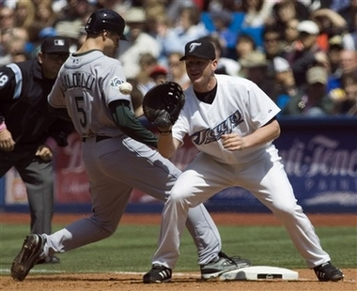
TYPES OF DIETRY FAT
SATURATED FATS
UNSATURATED FAT
TRANS FAT

Slide 12
WATER
water is just as imp. to unlocking your game power as food.
There is no one size fit all formula for how much water to drink .it depends on individual age , size, level of physical activity and temp.
We can add additional mineral in water n can use as mineral water

Slide 13
SOME MINERALS ADDED
MINERALS | MAIN FUNCTION
CALSIUM | Regulate heart rhythm Muscle contraction
IODINE | Regulate body’s production energy
MAGNESIUM | Regulation of blood pressure
IRON | Increase resistance to stress & disease
SODIUM | Regulate water balance in cells
POTASSIUM | An electrolyte maintain acid base balance

Slide 14
WHY Zn & Se ARE IMP. MINERALS
ZINC-it plays a role in protein metabolism & growth. Zn has never really been associated with enhanced aerobic performance
It increase muscle strength
It increase the level of carbonic anhydrase which plays a key role in facilitating the removal of carbon di oxide from energy producing cell.

Slide 15
SELANIUM- It maximise the effectiveness of the selanium dependent enzyme glutathionase peroxidase, a key enzyme in body’s antioxidant defance system , which help to nutralise highly reactive & damaging free redical.

Slide 16
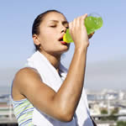
SPORTS DRINKS
Sports drink can be helpful to sports person who are exercising at a high intensity for 60 min. & hot climate bz
They provide extra calories for performance
Sports drink is ok once in while but remember those drinks have a lot of sugar & calories.
Water is a still best drink it contains no calories no sugar.
So avoid sodas. Specially caffinated drinks.

Slide 17
EFFECTS OF SPORTS DRINK
Sports drinks have great effect on teeth .the regular user of drinks have the risk of dental problem . They decrease the enamel of the teeth .
A resent studies has examine the effects of adding an inhibitor of tooth enamel corrosion known as cpp-ACP to sports drink .

Slide 18
CAFFEINE
Caffein is a diuretic. It is also added to the sports drink now days.
Although some studies have found that caffine may help with endurance sports performance.
It good to weigh any benefits against potential problem.
But too much amount can leave an sports person anxious feeling.
It can also cause trouble sleepin

Slide 19
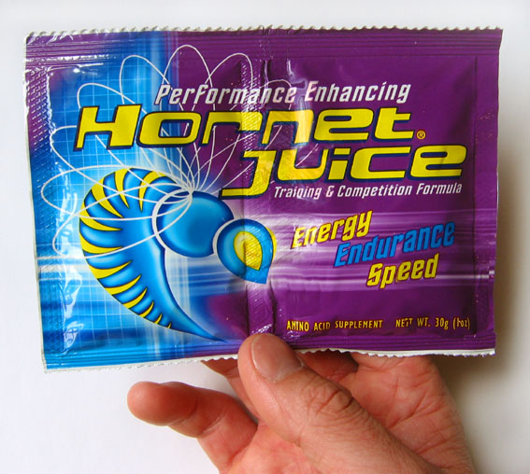
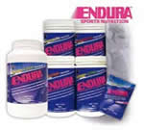
SOME PRODUCTS OF SPORTS DRINK

Slide 20
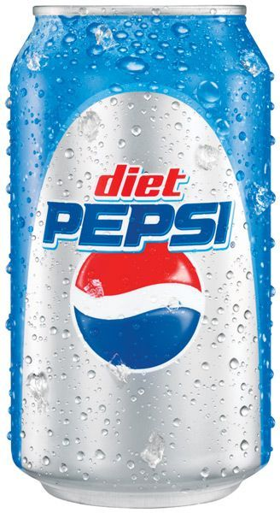
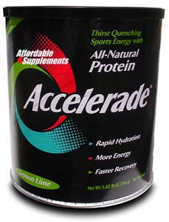
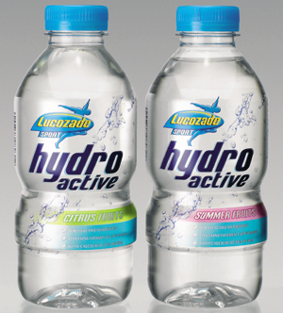

Slide 21
SUPPLEMENTS, PILLS & POWDER
It is known that no amount of expensive pill & powder can compensate for a less than adequate regular diet .
Proteins supplements & energy bars do not do a whole lot of good but they would not really do you much harm either but other type of supp. Can really do some damage.
Anabolic steroids can seriously mess with a person hormone. Can cause mental health problem including depression.

Slide 22
Salt tablets are another supp. To watch out for people take them to avoid dehydration but salt tablets can actually lead a person to become dehydrated.
In large amount salt can cause nausea, vomiting, cramps etc.

Slide 23
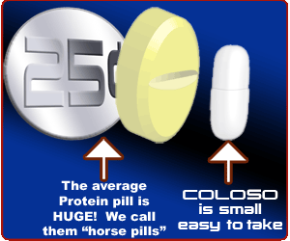
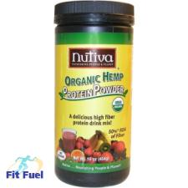
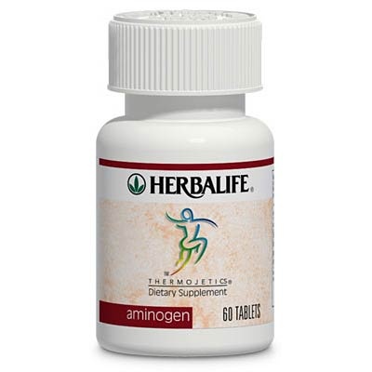
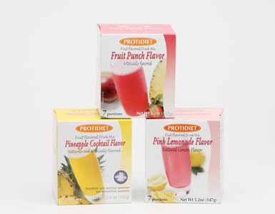
SOME PRODUCTS

Slide 24
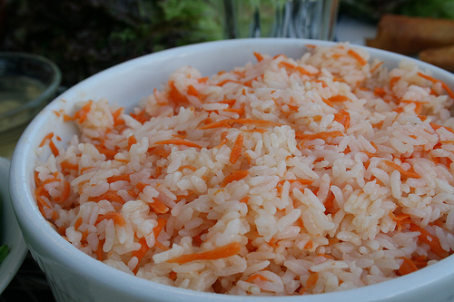
GAME DAY EATING
The game diet should be rich in carb.
Eat a meal2-4 hours before the game.(fruits veg. juices plumps with a protein & carb. Meal.)
Cn eat snack during the resting period of game. Mainly they should take liquid.

Slide 25
REFRENCES
WWW.GOOGLE.COM
WWW.YAHOO.COM
WWW.WIKIPEDIA.COM

Slide 26
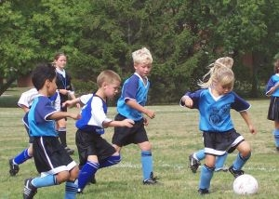
THANKS

